Slide 1
Sensor Pod Configuration at TFRI with PRIME Week 4
Thaddeus Trinh
July 24, 2013

Slide 2
Proposed Research
To work with TFRI to help integrate new sensors into their Android sensor pod network and to deploy and test the new sensors in the field
Fuel Moisture Sensor
Solar Irradiation Sensor
Soil Moisture Sensor
Soil Drainage Gauge

Slide 3
Progress (Week 5)
Received the SDI-12 to RS232 Translator for the CTD Sensor
Working on Integrating it

Slide 4
CTD Sensor
We received the SDI-12 to RS232 Translator and I was able to successfully connect it to the IOIO board
Successfully sent and received command to and from the translator, however still unable to receive data from the sensor
Potential Problems: Powering the sensor improperly, wiring the sensor the the translator improperly, sending commands that cannot be read by the translator and sent to the sensor

Slide 5

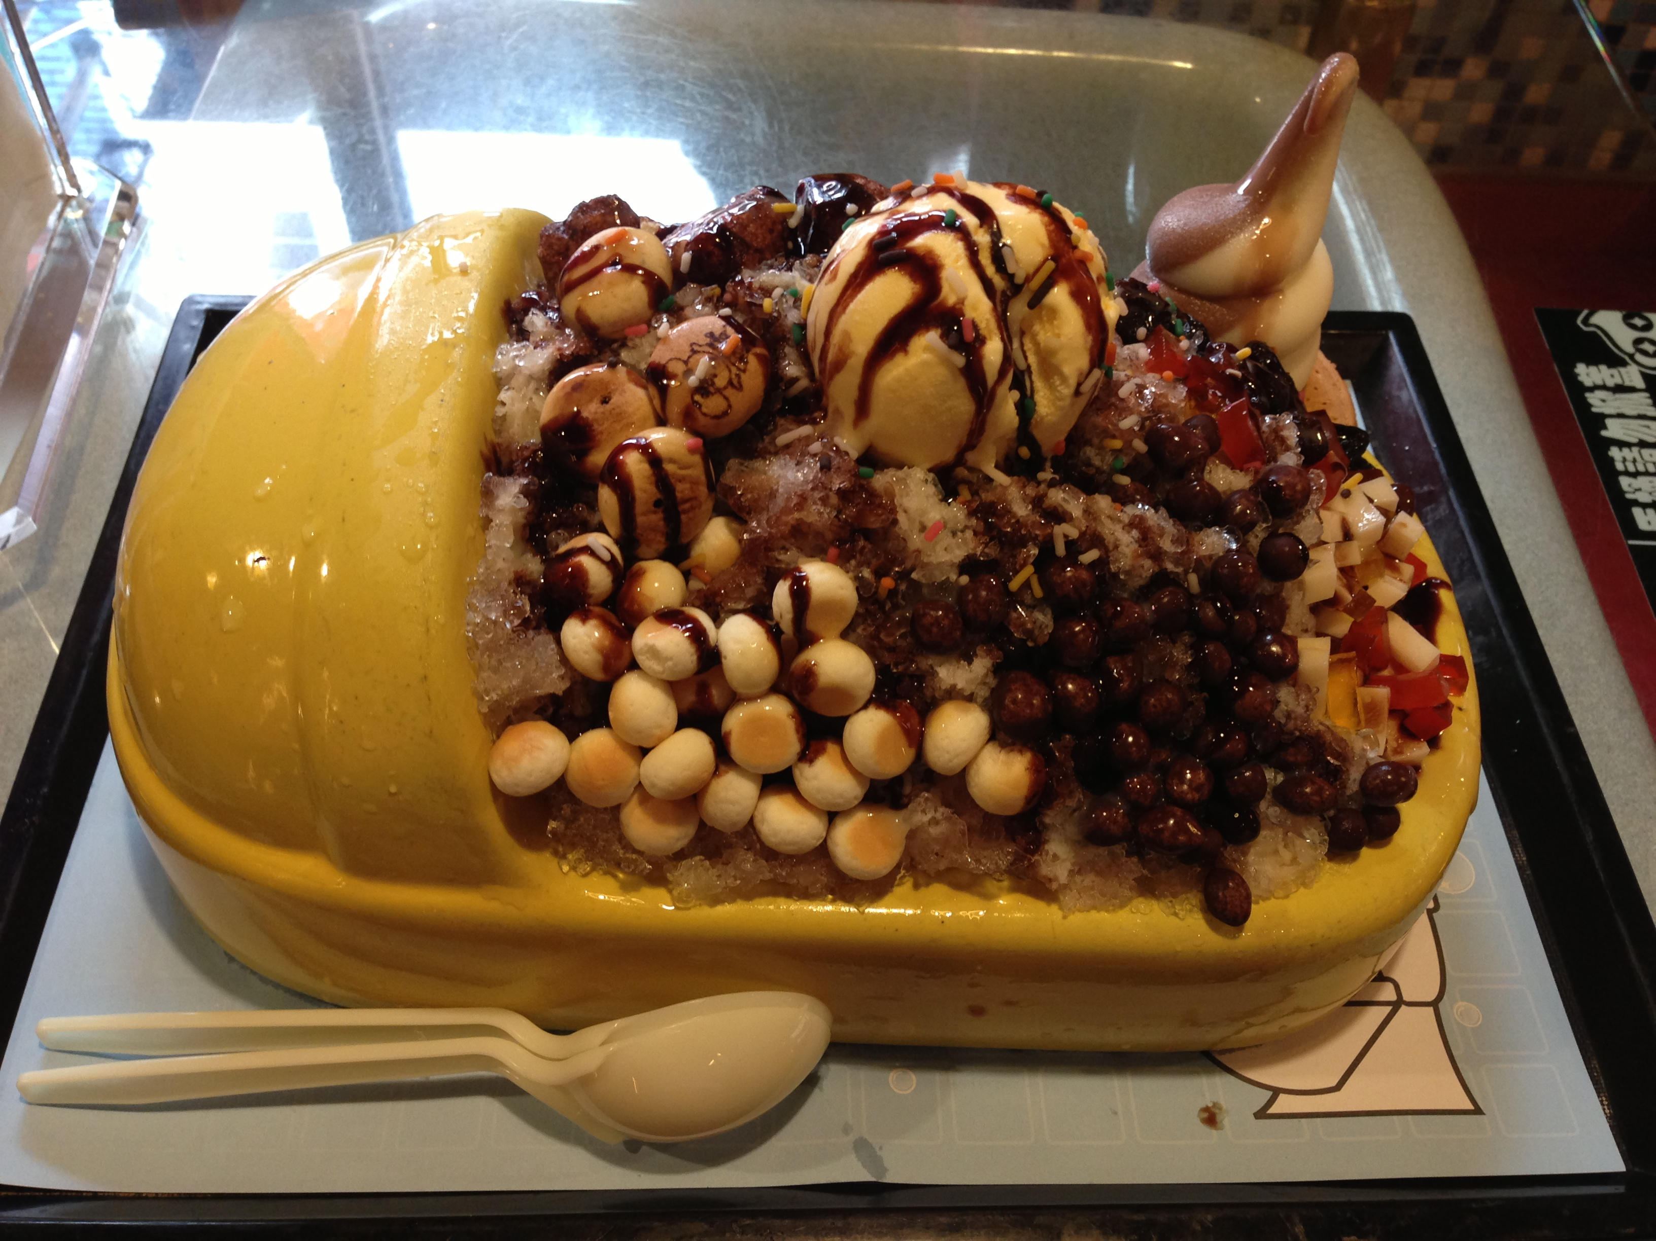
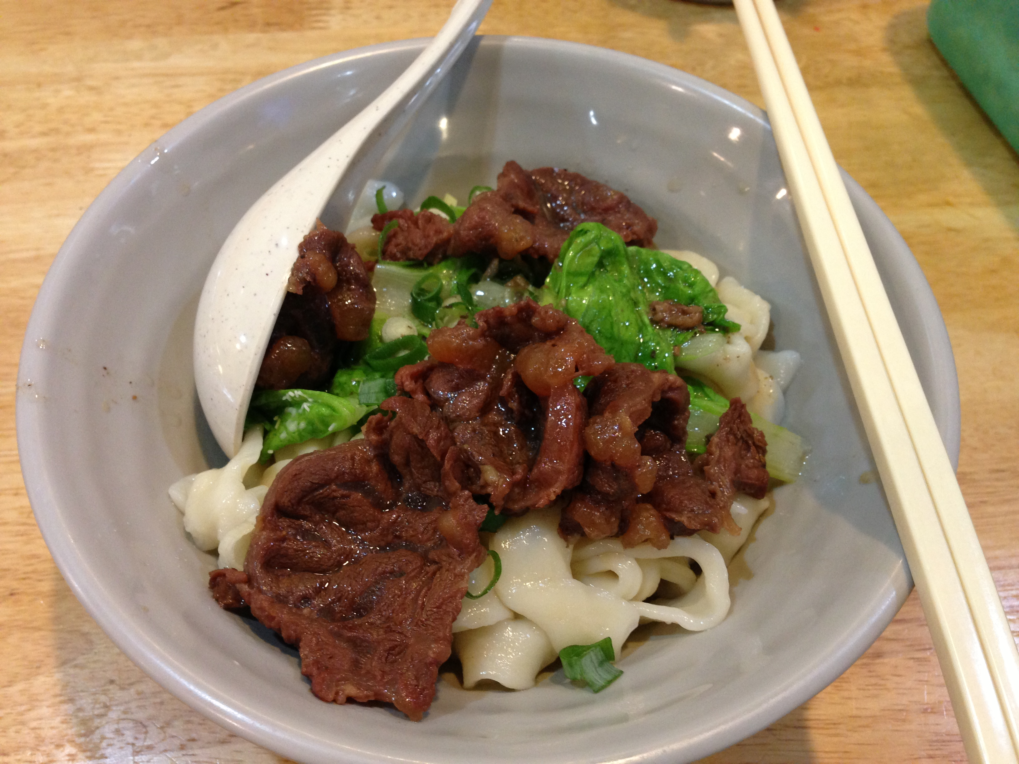
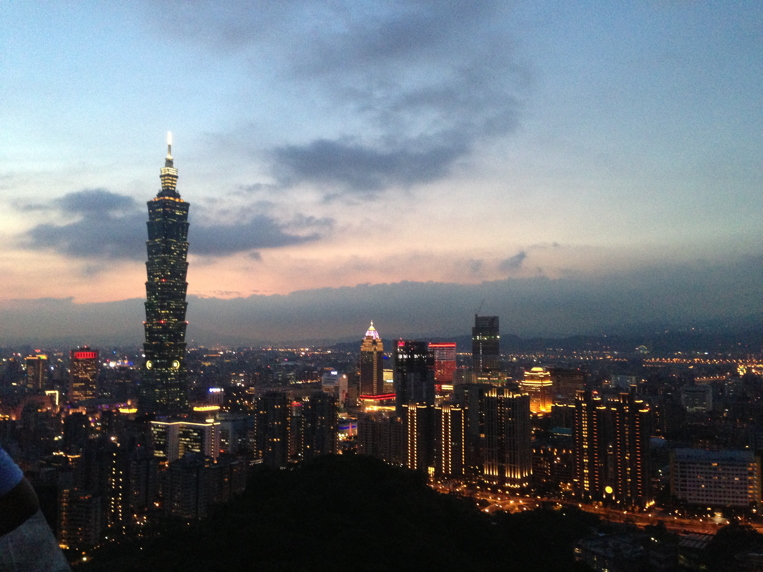
Culture

Slide 6
Acknowledgements
Mentors
Tony Fountain (CALIT2)
Chau Chin Lin (TFRI)
Sheng-Shan Lu (TFRI)
Yu-Huang Wang (TFRI)
Peter Shin (CALIT2)
PRIME
Peter Arzberger
Gabriele Wienhausen
Teri Simas
Tricia Taylor

